Slide 1

Pushdown Automata
Presented By:
Nikhil Singh

Slide 2

Contents
Basic Structure
Tuples
Turnstile Notation
PDA Acceptance
PDA & CFG
PDA & Parsing
Conclusion

Slide 3
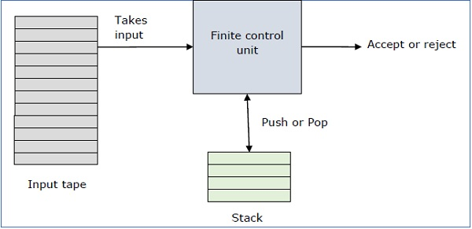
Basic Structure of PDA
A pushdown automaton is a way to implement a context-free grammar in a similar way we design DFA for a regular grammar. A DFA can remember a finite amount of information, but a PDA can remember an infinite amount of information. Pushdown Automata is a finite automata with extra memory called stack which helps Pushdown automata to recognize Context Free Languages.
Basically a pushdown automaton is: –
"Finite state machine" + "a stack“
A PDA has three components −
an input tape
a control unit
a stack with infinite size.
The stack head scans the top symbol of the stack.
A stack does two operations −
Push − a new symbol is added at the top
Pop − the top symbol is read and removed.

Slide 4
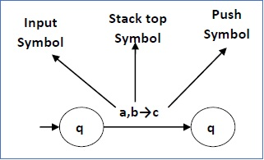
Tuples Of PDA:
The following diagram shows a transition in a PDA from a state q₁ to state q₂, labeled as a,b → c
A PDA can be formally described as a 7-tuple (Q, ∑, S, δ, q₀, I, F) −
Q is the finite number of states
∑ is input alphabet
S is stack symbols
δ is the transition function: Q × (∑ ∪ {ε}) × S × Q × S*
q₀ is the initial state (q₀ ∈ Q)
I is the initial stack top symbol (I ∈ S)
F is a set of accepting states (F ∈ Q)

Slide 5
Turnstile Notation
The "turnstile" notation is used for connecting pairs of ID's that represent one or many moves of a PDA. The process of transition is denoted by the turnstile symbol "⊢".
Consider a PDA (Q, ∑, S, δ, q₀, I, F). A transition can be mathematically represented by the following turnstile notation –
(p, aw, Tβ) ⊢ (q, w, αb)
This implies that while taking a transition from state p to state q, the input symbol ‘a’ is consumed, and the top of the stack ‘T’ is replaced by a new string ‘α’.
Note − If we want zero or more moves of a PDA, we have to use the symbol (⊢*) for it.

Slide 6
PDA Acceptance
There are two different ways to define PDA acceptability.
1. Final State Acceptability.
2. Empty Stack Acceptability.
Final State Acceptability
Accepts a string when, after reading the entire string, the PDA is in a final state.
From the starting state, we can make moves that end up in a final state with any stack values.
The stack values are irrelevant as long as we end up in a final state.
For a PDA (Q, ∑, S, δ, q₀, I, F), the language accepted by the set of final states F is −
L(PDA) = {w | (q₀, w, I) ⊢* (q, ε, x), q ∈ F}for any input stack string x.
Empty Stack Acceptability
Here a PDA accepts a string when, after reading the entire string, the PDA has emptied its stack.
For a PDA (Q, ∑, S, δ, q₀, I, F), the language accepted by the empty stack is −
L(PDA) = {w | (q₀, w, I) ⊢* (q, ε, ε), q ∈ Q}

Slide 7
PDA & Context Free Grammar
Algorithm to find PDA corresponding to a given CFG
Input − A CFG, G = (V, T, P, S)
Output − Equivalent PDA, P = (Q, ∑, S, δ, q₀, I, F)
Step 1 − Convert the productions of the CFG into GNF.
Step 2 − The PDA will have only one state {q}.
Step 3 − The start symbol of CFG will be the start symbol in the PDA.
Step 4 − All non-terminals of the CFG will be the stack symbols of the PDA and all the terminals of the CFG will be the input symbols of the PDA.
Step 5 − For each production in the form A → aX where a is terminal and A, X are combination of terminal and non-terminals, make a transition δ (q, a, A).
Algorithm to find CFG corresponding to a given PDA
Input − A CFG, G = (V, T, P, S)
Output − Equivalent PDA, P = (Q, ∑, S, δ, q₀, I, F) such that the non- terminals of the grammar G will be {X_{wx} | w,x ∈ Q} and the start state will be A_{q0,F}.
Step 1 − For every w, x, y, z ∈ Q, m ∈ S and a, b ∈ ∑, if δ (w, a, ε) contains (y, m) and (z, b, m) contains (x, ε), add the production rule X_{wx} → a X_{yz}b in grammar G.
Step 2 − For every w, x, y, z ∈ Q, add the production rule X_{wx} → X_{wy}X_{yx} in grammar G.
Step 3 − For w ∈ Q, add the production rule X_{ww} → ε in grammar G.

Slide 8
PDA & Parsing
Parsing is used to derive a string using the production rules of a grammar. It is used to check the acceptability of a string. Compiler is used to check whether or not a string is syntactically correct. A parser takes the inputs and builds a parse tree.
A parser can be of two types −
Top-Down Parser − Top-down parsing starts from the top with the start-symbol and derives a string using a parse tree.
Bottom-Up Parser − Bottom-up parsing starts from the bottom with the string and comes to the start symbol using a parse tree.

Slide 9
Conclusion
Automata can be augmented with a memory storage to increase their power.
● PDAs are finite automata equipped with a stack.
● PDAs accept precisely the context-free languages:
● Any CFG can be converted to a PDA.
● Any PDA can be converted to a CFG.
● Deterministic PDAs are strictly weaker than nondeterministic PDAs.
• a push-down automaton checks to see that the keywords/numbers are in proper grammatical order
• a linear bounded automaton checks all context-sensitive characteristics of the code, such as the scope of each definition, etc., and generates machine code

Slide 10
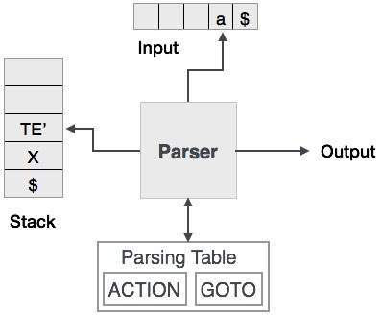
CSE(B) 4th semester

